Slide 1
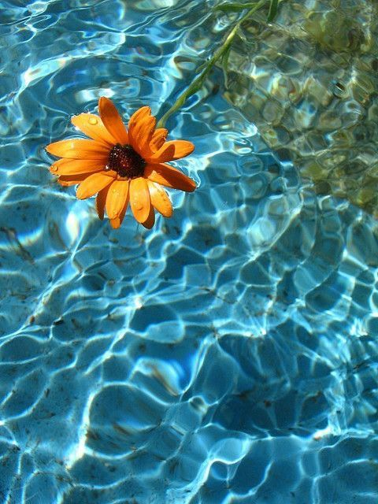
WATER
İstanbul/TURKEY

Slide 2
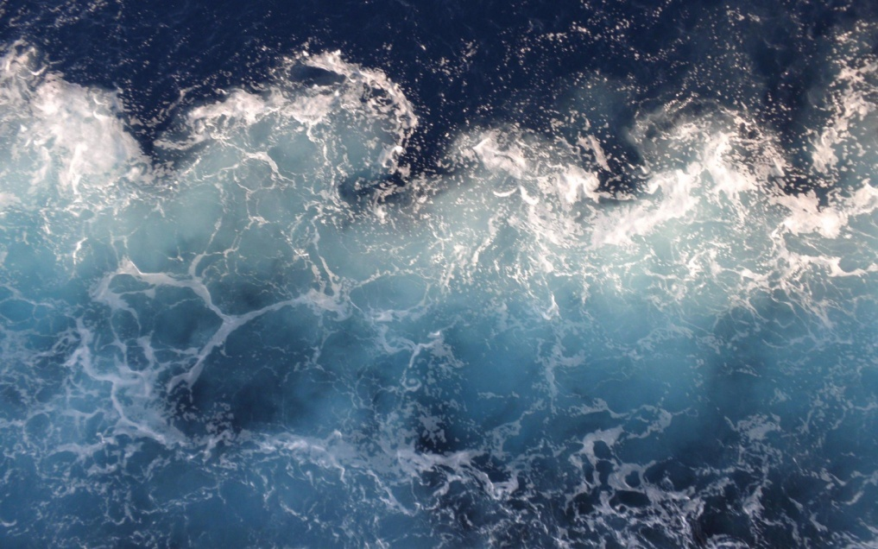
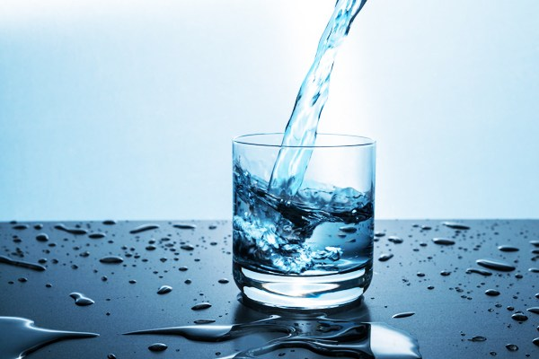
THE IMPORTANCE OF WATER

Slide 3
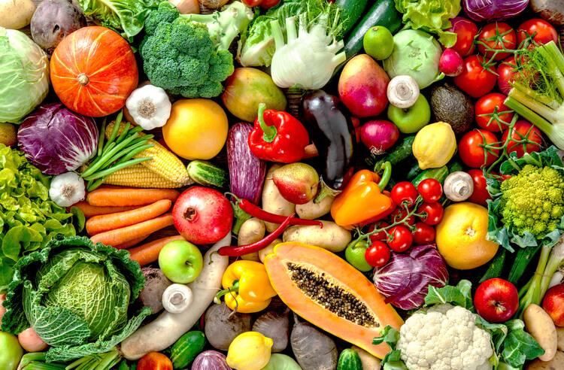
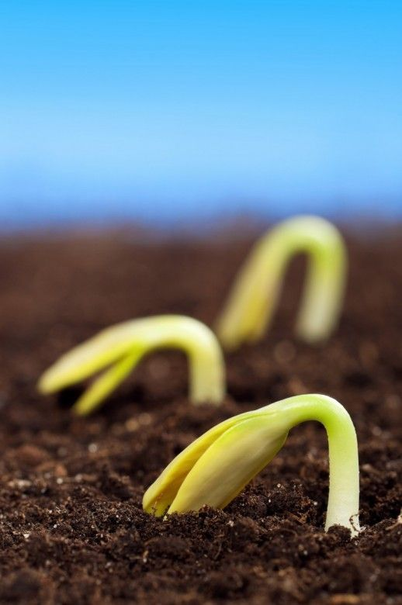
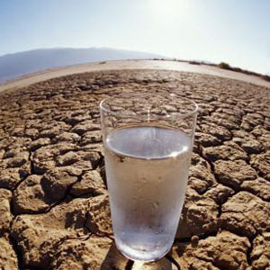
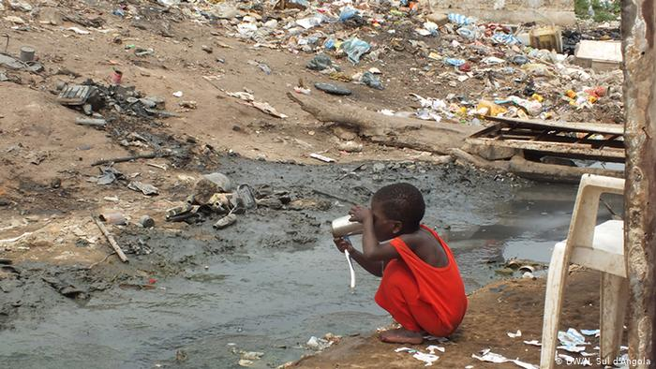
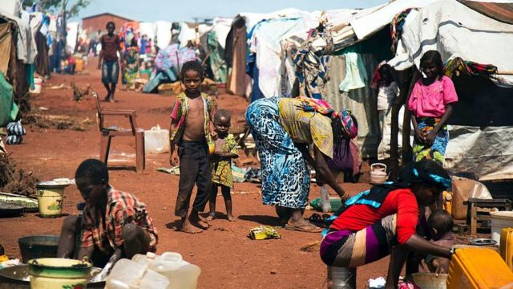
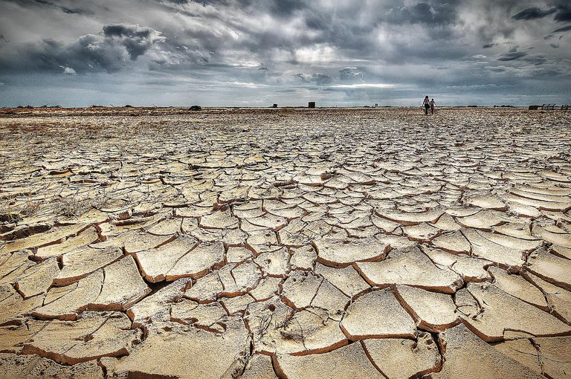

Slide 4
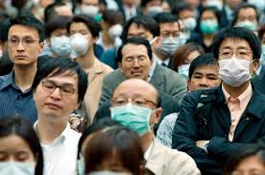
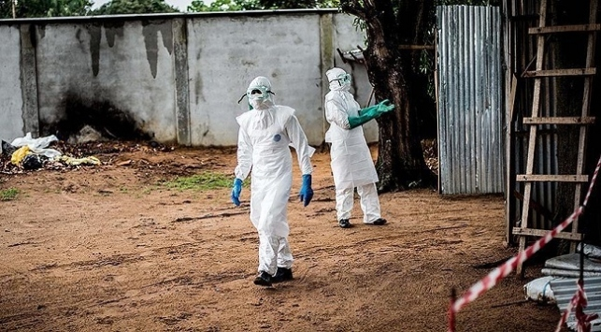
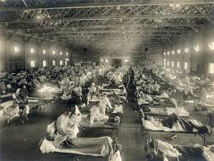

Slide 5
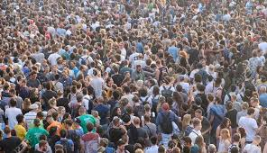
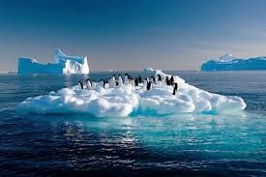
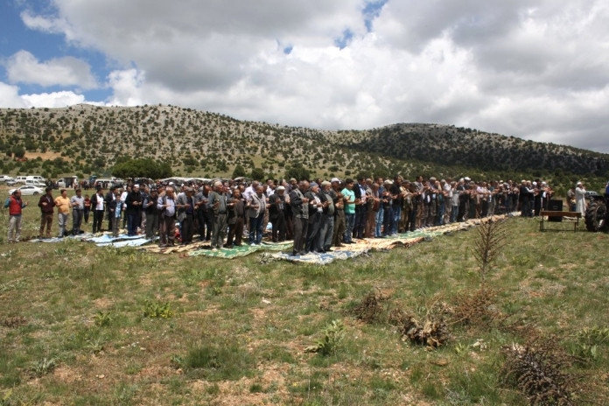
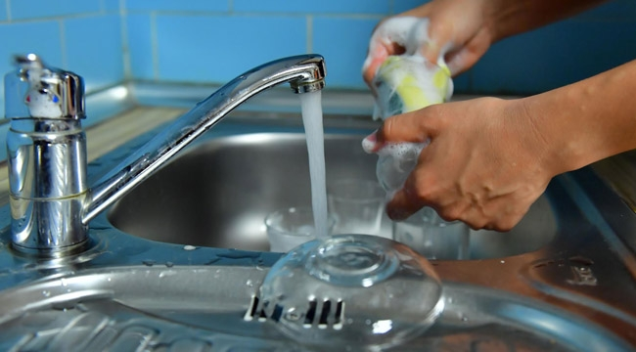
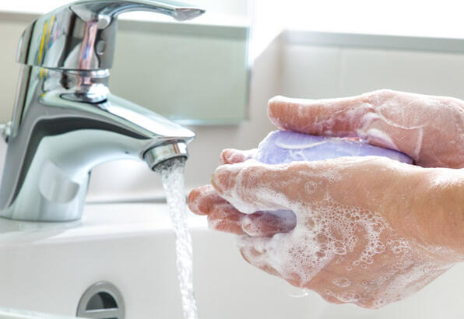
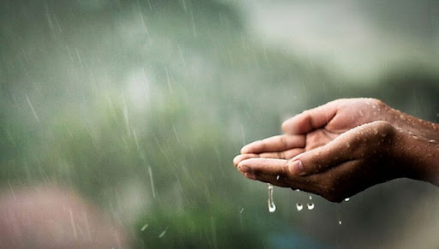

Slide 7
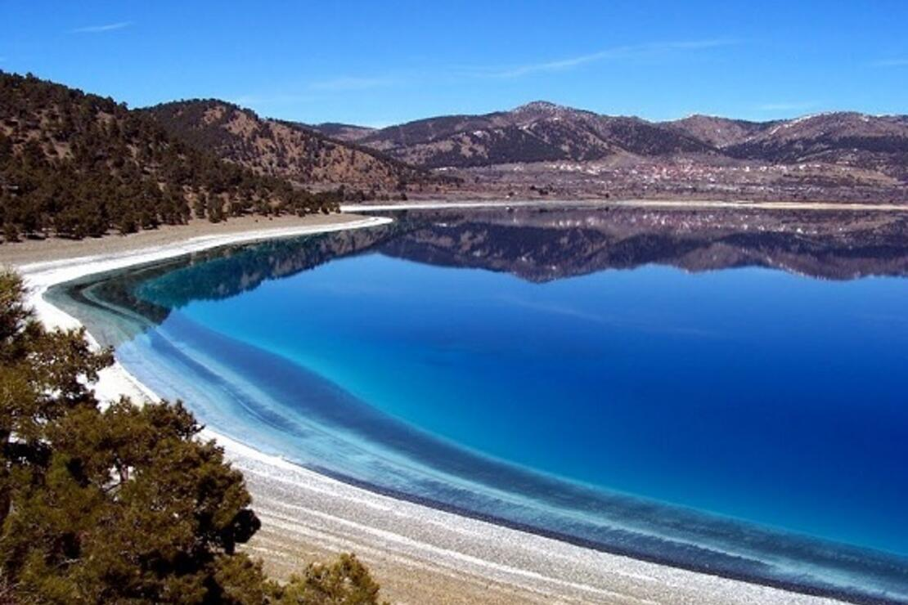
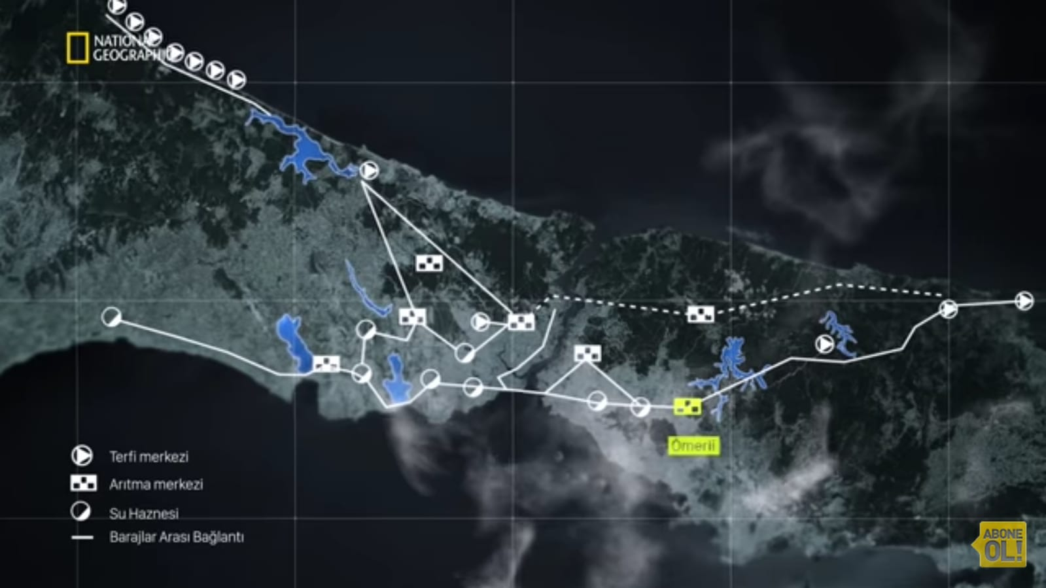
WATER IN ISTANBUL AND TURKEY
Turkey’s and Istanbul’s water resources are underground water, streams, lakes, ponds, rivers, spring water dams, transmission lines and water treatment facilities but increasing population, rapid urbanizaiton, climate change and repeated droughts threaten Istanbul and Turkey.

Slide 8
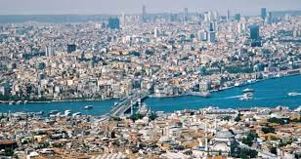
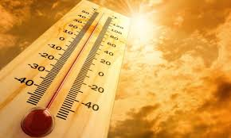
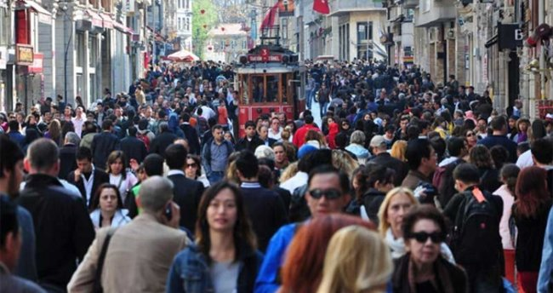
Experts predict the air temperature in Istanbul to increase by 2-3 degrees by 2040 and spring rain to decrease by 20 percent. There is lack of water in Istanbul because there are a lot of buildings and if our population continues to increase at this rate whatever we do, this water will not be enough for us in the next 20-30 years.

Slide 9
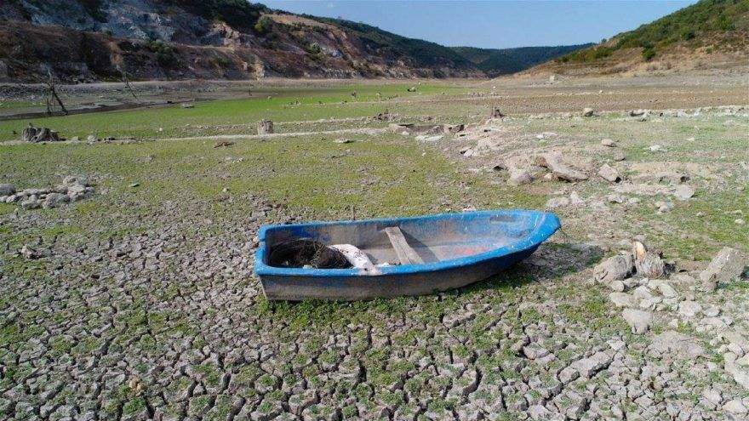
Only in Istanbul, 190liters of water is consumed per person daily. İstanbul generally experience a dry season every seven years and an extremely dry season every 14 years. This drought was experienced in 2007 and in 2014 the water in dams descreased as low as 10%.
190 LITERS

Slide 10
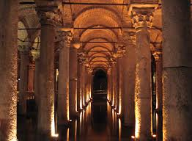
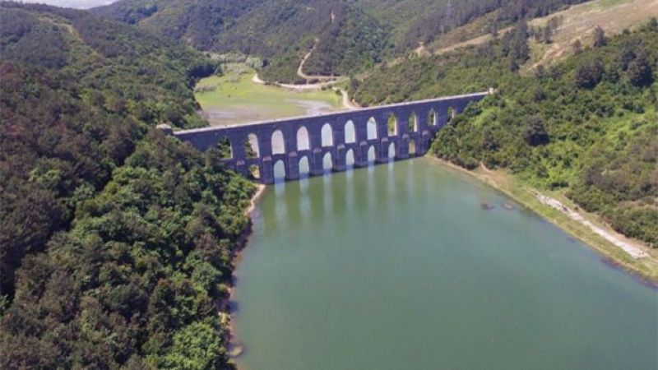
It has always been very difficult to bring water to Istanbul. Throughout history many cisterns and aqueducts were built but they are not enough for today’s Istanbul.On the other hand, a solution has always been found up to now.

Slide 11
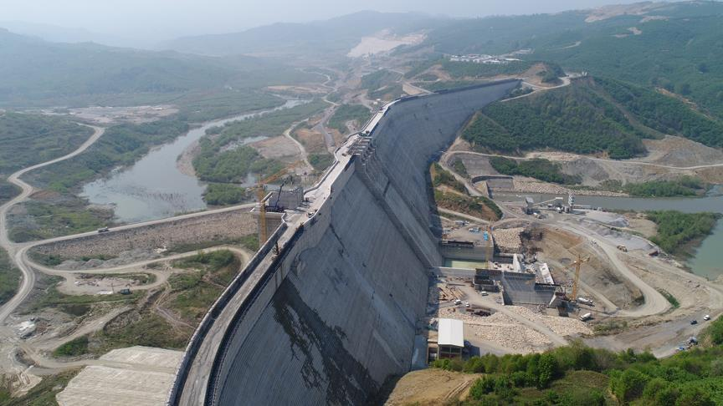
Today the biggest source that supplies water to Istanbul is “Melen”dam. But we can not trust it so much because there is no endless water source.

Slide 12
In Turkey, water usage percentage: 75% ➜ in farming 15% ➜ in our houses 10% ➜ in industry As we can see, water consumption is not just about consuming water at the taps. And here is the thing: virtual water

Slide 13
VIRTUAL WATER(WATER FOOTPRINT)
Via everything we buy, sell, eat and wear we consume water indirectly. For example ➜

Slide 14
And we calculated our own water footprints:
Mücahit: 2483
İpek: 1171
If you would like to calculate yours, you can visit:
www.watercalculator.org

Slide 15
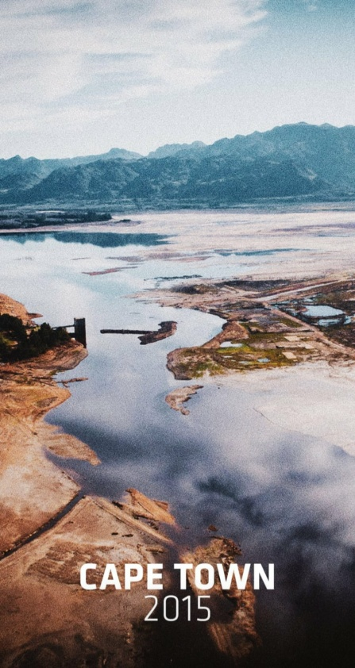
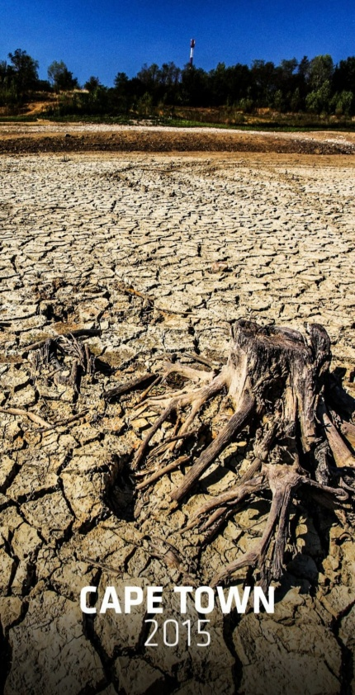
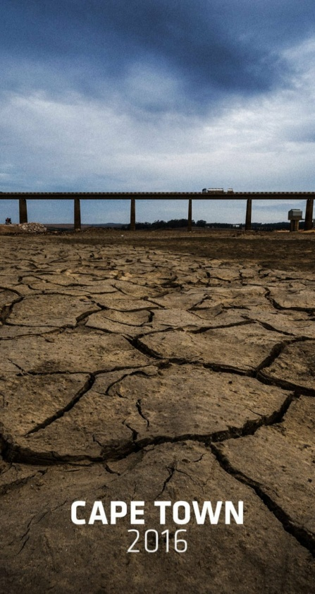
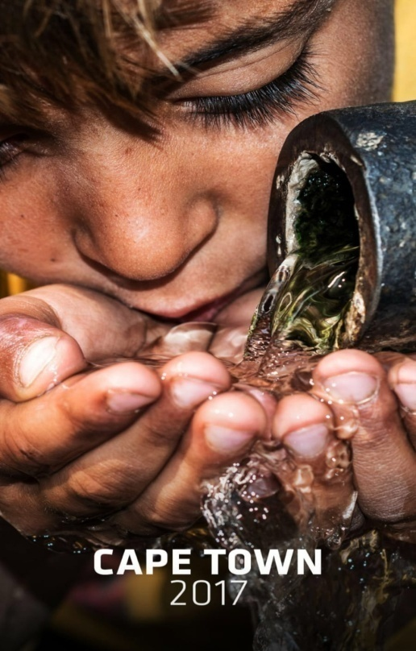
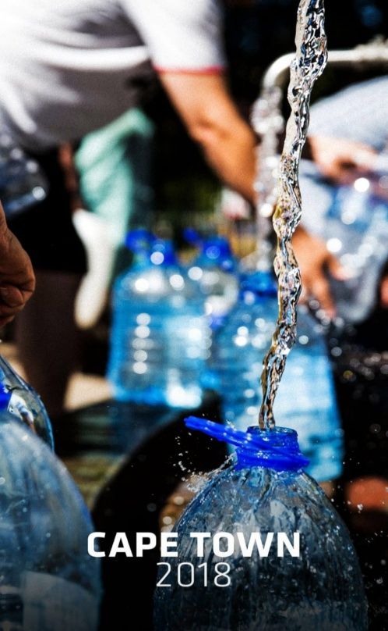
Water shortage problem is not valid only for Turkey or Istanbul. It is a very important problem affecting the whole world. Do you think there is any country that restricts the water of its citizens due to water shortage? Yes, there is: Cape Town.Cape Town is the first major city in the world to limit its citizens’ water to only 50 liters per person per day due to water shortage. So why do they do so? Is it just a water problem? No. There are other reasons besides the water problem: to prevent day zero.

Slide 16
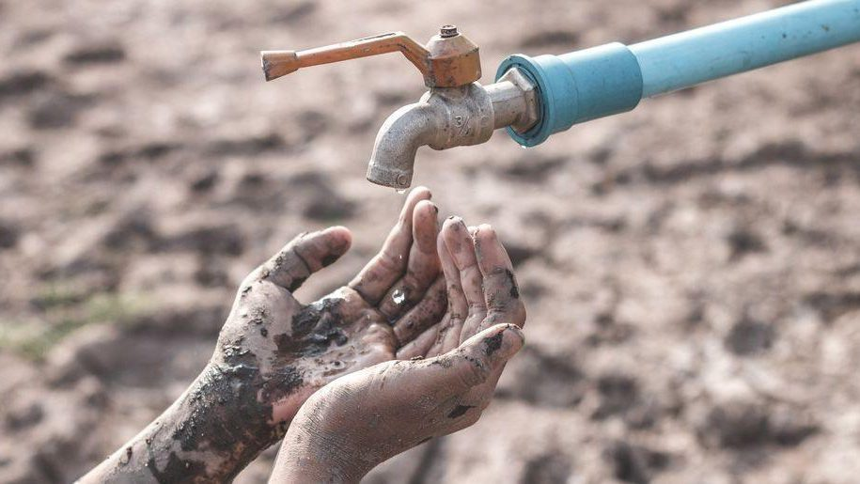
25 LITERS AND DAY ZERO
Day zero means running out of drinkable water in a city. So Cape Town is experiencing day zero and unfortunately therefore, it had to limit its water consumption to 50 liters per day if the zero day comes, it will be limited to half of it: just 25 liters.

Slide 17
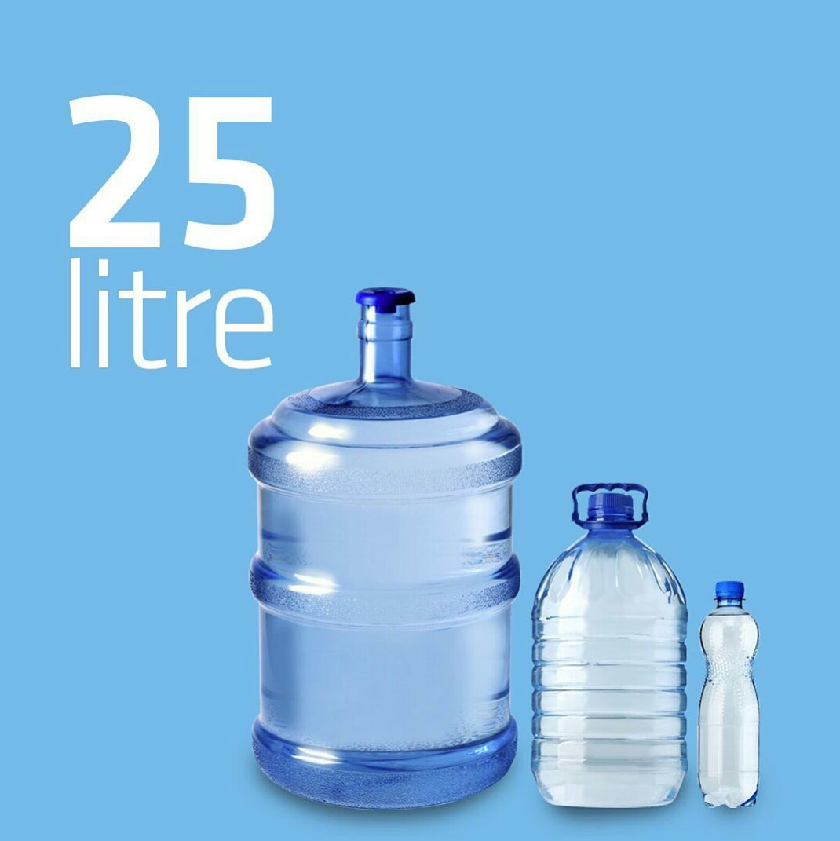
Tourists visiting Cape Town, which has been experiencing it’s worst drought of the century, are told to limit their showers to 90 seconds,use the reservoirs in the toilets as little as possible and swim in the sea rather than in the pools. Bathroom taps have been removed in hotels, automatic washing systems for urinals in bars and restaurants have been disabled and car rental companies have stopped washing their cars.

Slide 18
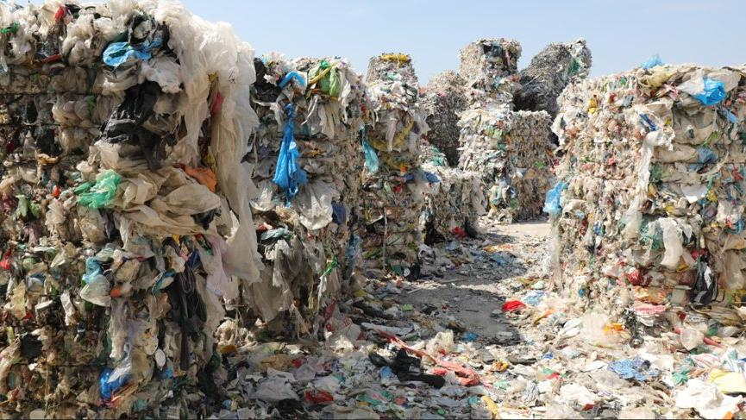
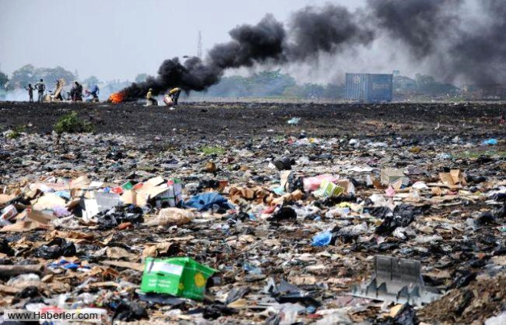
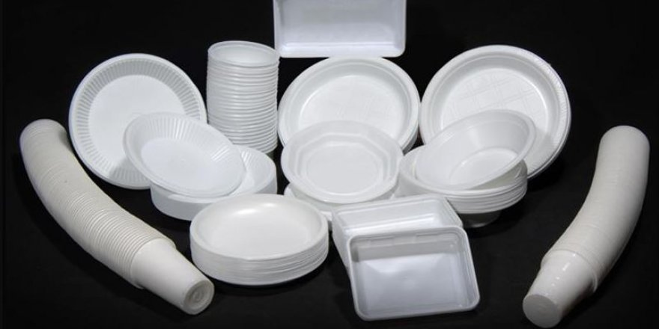

Slide 19
Normally, we consume about 190 liters of water per person in İstanbul in a day but we challenged to spend a day with just 25 liters of water as in Day Zero. Let’s watch them if you like. Firstly mine then Mücahit’s are coming:

